Slide 1


Engineered Self-Organization Approaches to Adaptive Design
Jacob Beal
Conference on Through-Life Engineering Services
Nov 5-6th, 2012
Work partially sponsored by DARPA; the views and conclusions contained in this document are those of the authors and not DARPA or the U.S. Government.

Slide 2
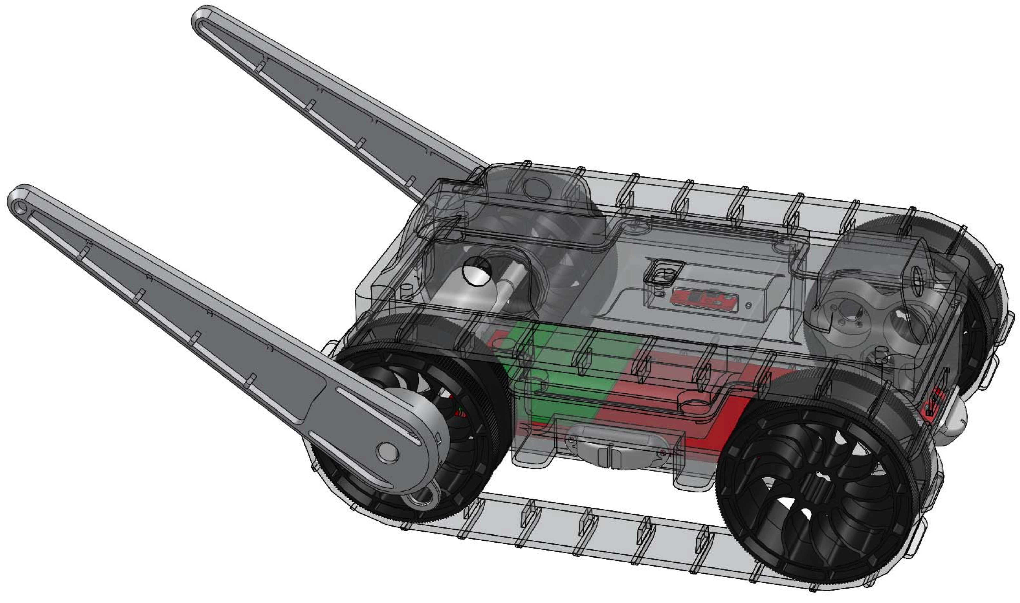
Design: Explicit → Implicit
Design fragility from “compiled away” assumptions…
Required field
endurance
Flip self over
Maintain speed
Climb steps
Drive on rough terrain
… can be mitigated by autonomous, ongoing integration
Maintenance as a side-effect of normal operation
Self-organization phenomena are useful building blocks!

Slide 3
Outline
Engineered Self-Organization
Three techniques:
Networks as manifolds
Stochastic coordination
Functional blueprints
Summary & Future outlook

Slide 4
Definitions:
Self-Organization is aggregate structure or behavior that arises from local interactions
“local-to-global” solutions
Engineered Self-Organization is design that predictably leads to specified self-organization

Slide 5
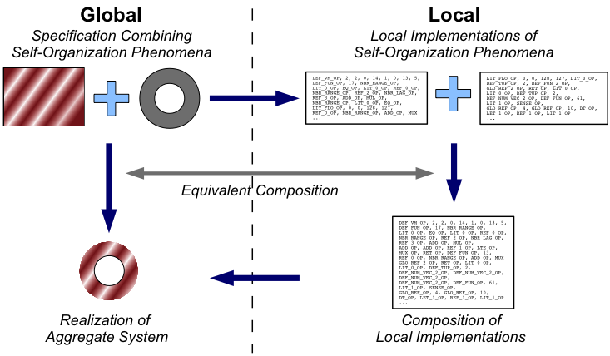
Key: Equivalent Composition Models
Value: only specify aggregate behavior, details autonomously set at runtime
Cost: initial design harder, extra overhead, NO SILVER BULLET

Slide 6
Outline
Engineered Self-Organization
Three techniques:
Networks as manifolds
Stochastic coordination
Functional blueprints
Summary & Future outlook

Slide 7

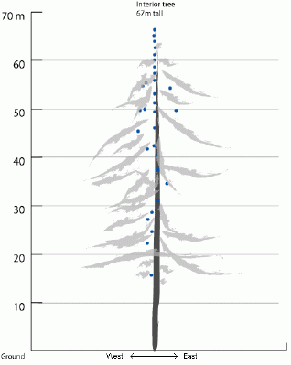
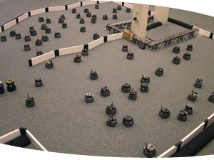
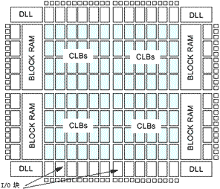
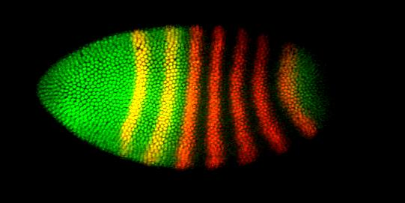
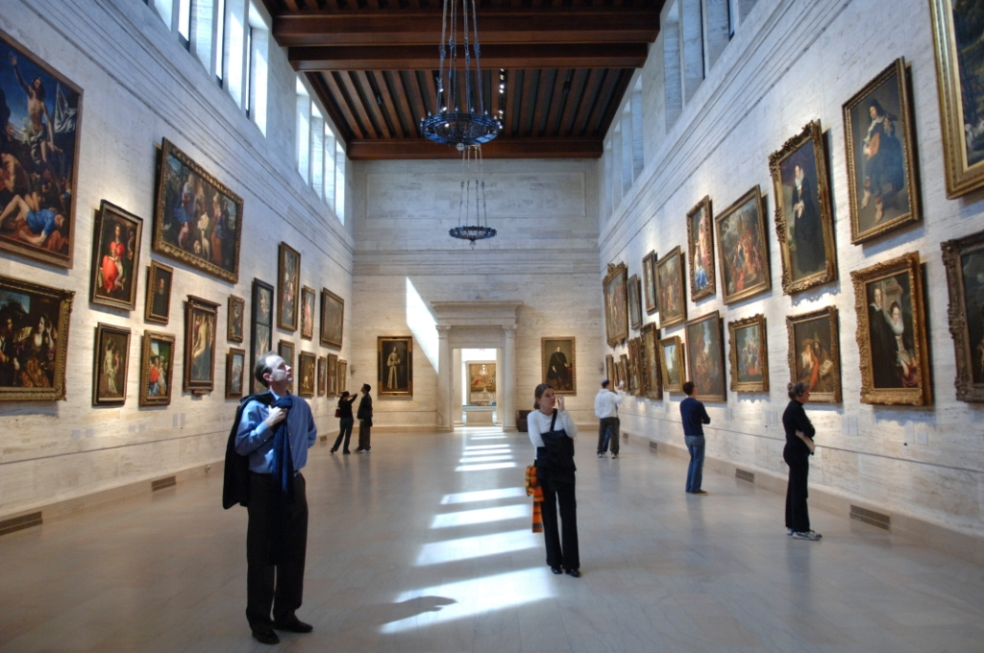
Spatial Computers
Biological Computing
Sensor Networks
Robot Swarms
Cells during Morphogenesis
Reconfigurable Computing
Pervasive Computing
Notes:
A spatial computer is any collection of devices distributed to fill space, where the difficulty of moving information between two devices is strongly dependent on the distance between them.

Slide 8
Amorphous Medium
Global: network
Local: message passing
Link: amorphous medium
device
neighborhood
Continuous space & time
Infinite number of devices
See neighbors' past state
Approximate with:
Discrete network of devices
Signals transmit state

Slide 9
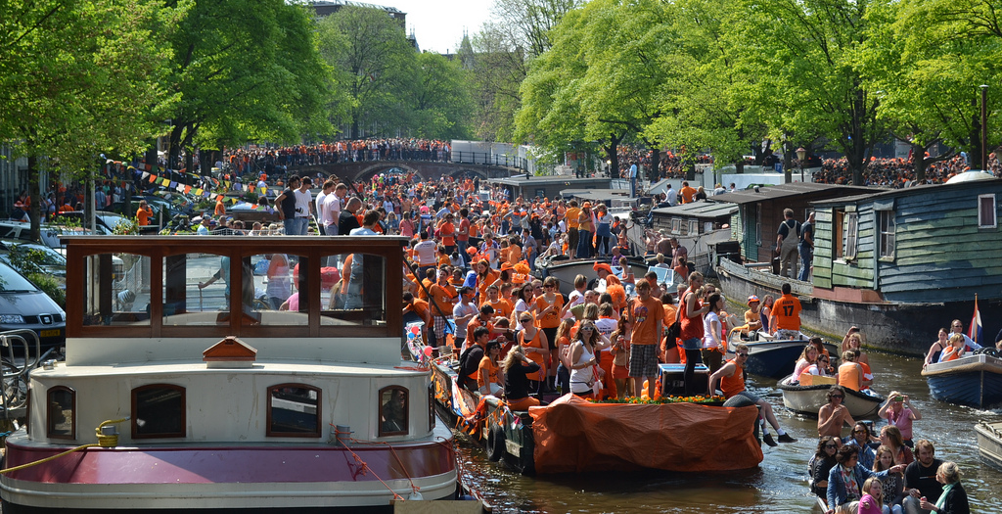
Example: Mesh-Network Cell Phones

Slide 10
Geometric Program: Channel
Source
Desti-
nation
(cf. Butera ‘02)

Slide 11
Computing with fields
source
destination
width
distance-to
distance-to
distance
10
37
+
dilate
<=
Notes:
Functional computation on time-dependent fields

Slide 12
Proto
(def gradient (src) ...)
(def distance (src dst) ...)
(def dilate (src n)
(<= (gradient src) n))
(def channel (src dst width)
(let* ((d (distance src dst))
(trail (<= (+ (gradient src)
(gradient dst))
d)))
(dilate trail width)))
evaluation
global to local
compilation
Global Local Discrete
platform
specificity &
optimization
device
neighborhood
discrete
approximation
Device
Kernel
[Beal & Bachrach, IEEE Intel.Sys. '06]

Slide 13
Proto's Families of Primitives
Pointwise
Restriction
+
restrict
Feedback
Neighborhood
41
7
delay
+
nbr
any-hood
48
Formal semantics: [Beal, Usbeck & Benyo, Comp.J. 2012], [Viroli, Beal & Usbeck, Sci.Comp.Prog. 2012]

Slide 14
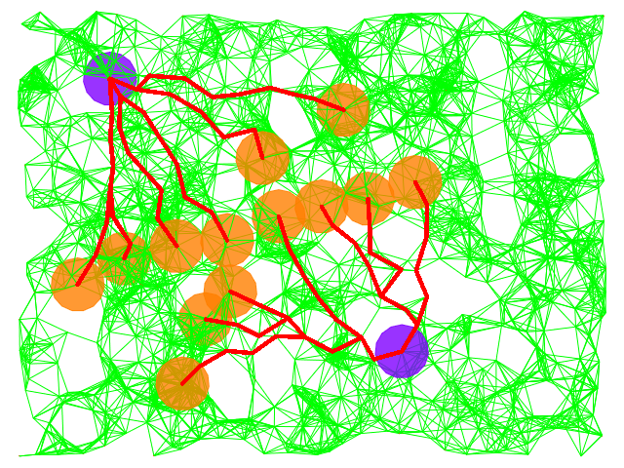
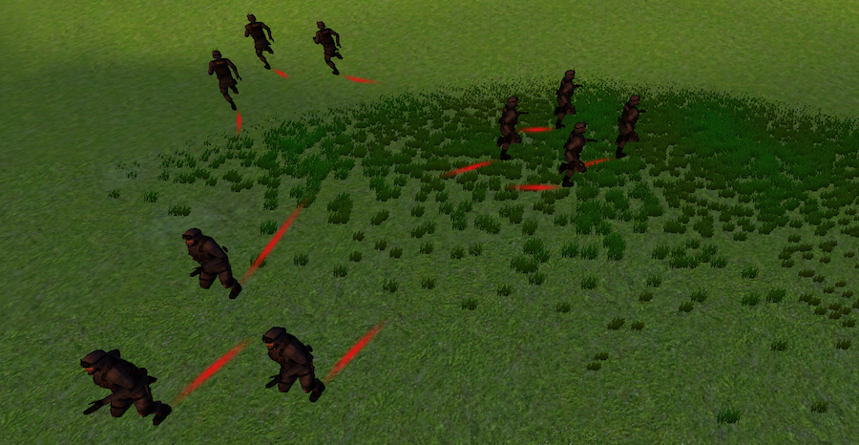
Example Applications
Synthetic Biology
Decentralized publish/subscribe
Agent-based tactical simulation
Swarm search and rescue
[Beal et. al., ACS Syn.Bio. 2012] [Usbeck & Beal, AGERE 2011]
[Beal, Usbeck & Krisler, SCW 2012] [Bachrach, Beal & McLurkin,NCA 2010]

Slide 15
Outline
Engineered Self-Organization
Three techniques:
Networks as manifolds
Stochastic coordination
Functional blueprints
Summary & Future outlook

Slide 16
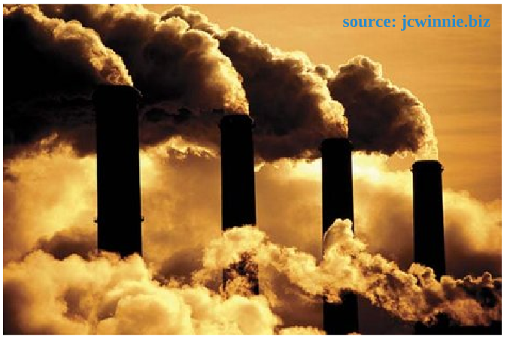
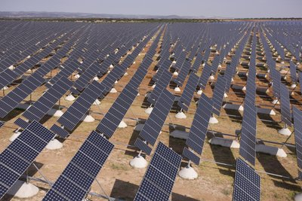
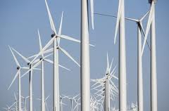
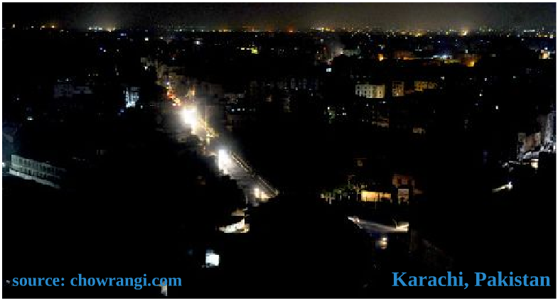
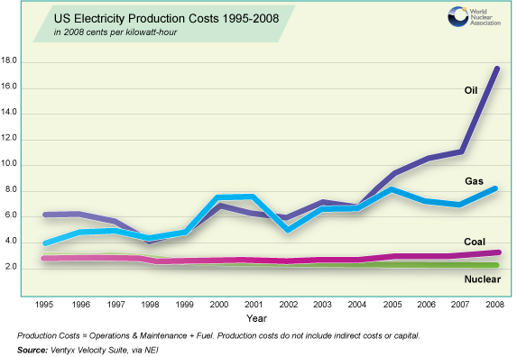
Problem: Energy Demand Response
Renewables Integration
Pollution Reduction
Why is DR important?
Peak Power
Costs
Blackout Prevention

Slide 17
Inefficiency of Demand vs. Intention
Demand/supply mismatch is extremely costly
$ billions to utilities, local governments
Consumers dramatically reduce demand when:
… aware of actual appliance energy use
… informed about neighbors' energy use
… aware of stress on power grid
Coordination opportunity: peak-shaving & demand management by automating volunteerism
Challenges: privacy, scalability, deployability, consumer interface…

Slide 18
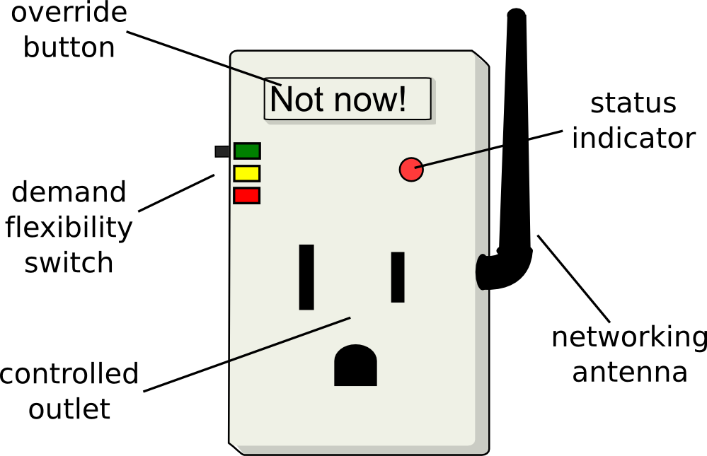
Capturing User Requirements
Anytime Flexible
Peak Power
Emergencies Only
Uncontrolled
Qualitative
Energy Flexibility
Smart plugs, new appliances,
home automation, …
Servitization of electricity:
Input based → performance based
(need-fulfillment)

Slide 19
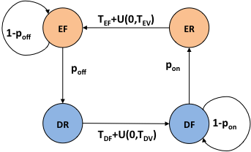
ColorPower State Transitions
Global: energy demand
Local: appliance on/off
Link: law of large numbers
(E)nabled vs. (D)isabled
(R)efractory vs. (F)lexible
[Ranade & Beal, SASO 2010], [Beal, Berliner & Hunter, SASO 2012]

Slide 20
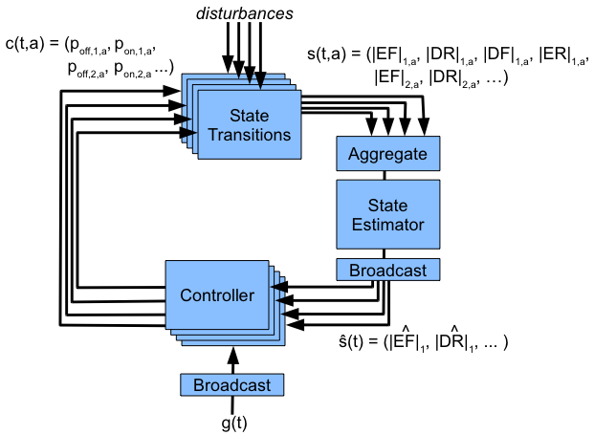
Formal Control Problem
For each ColorPower client, set p_{on}, p_{off} for each device group, such that the total enabled power in s(t) tracks g(t)

Slide 21
ColorPower Algorithm: Intuition
Fairness assured by executing equivalent stochastic algorithm on all clients
Intuition: spend flexibility with three “allocations”
Goal tracking & hard priority constraints
Soft priority
Cycling (trading off fairness against future reserves)
Any “unspent” flexibility is allowed to accumulate, improving future controllability

Slide 22
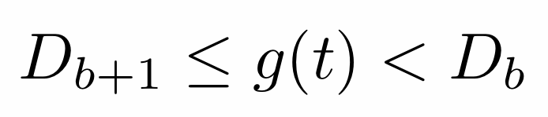
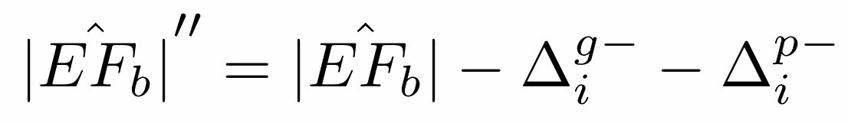
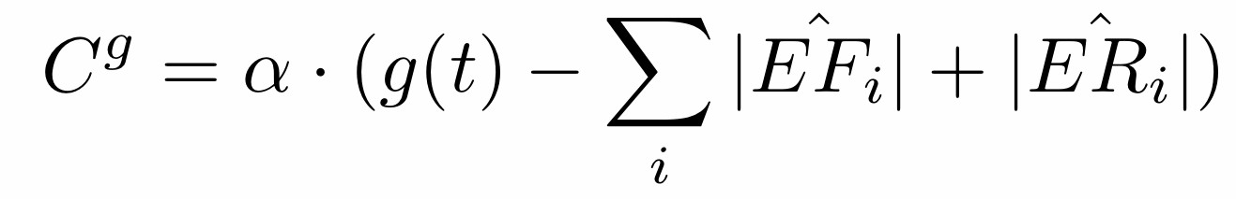
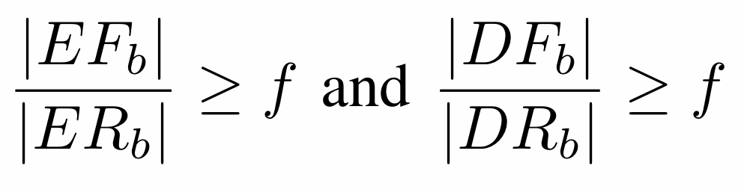
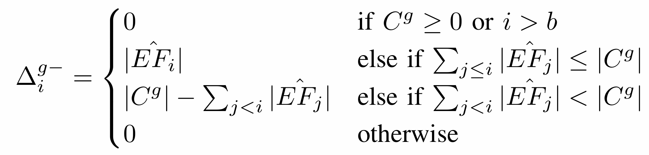
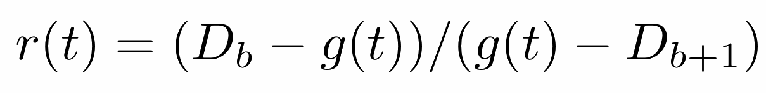
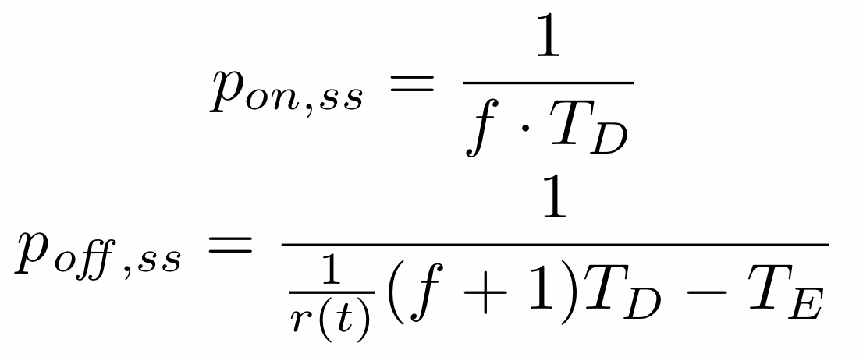
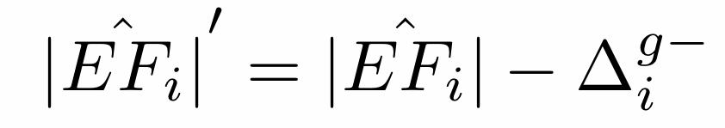
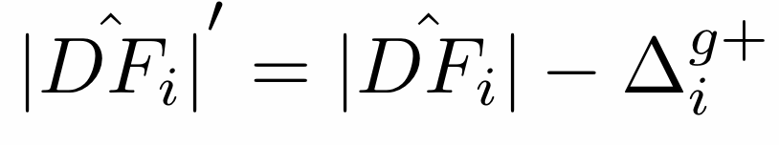
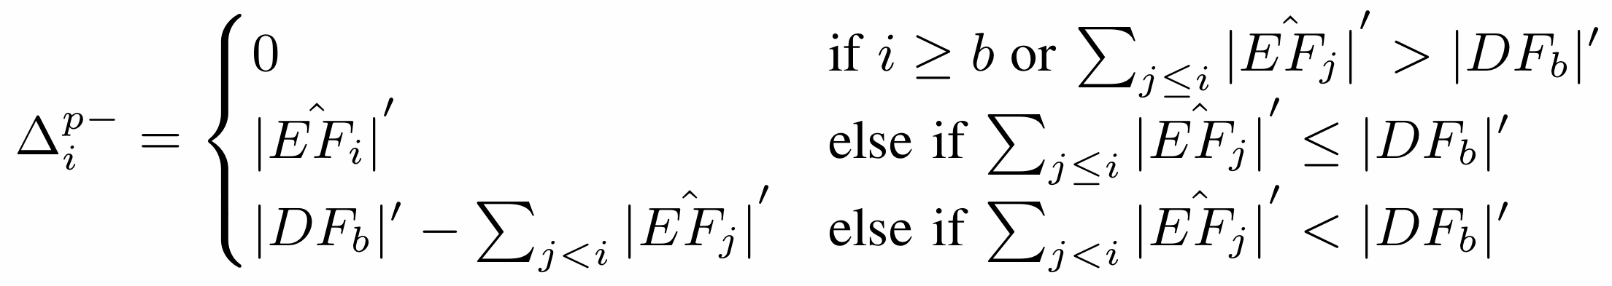
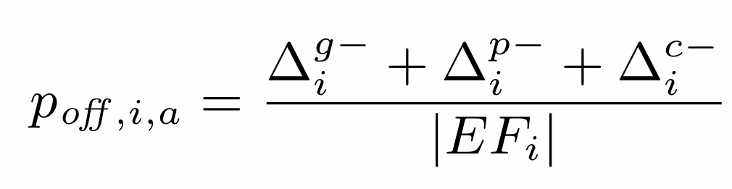
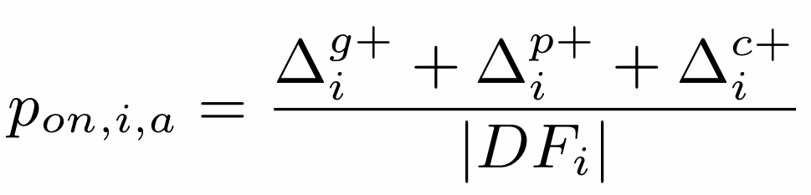
ColorPower Algorithm: Equations
Allocation 3: Cycling
Boundary color b:
Allocation 1: Goal Tracking
and similar for other states
Correction Goal:
Reserve fraction f:
Downward shift:
when enabled
domainates,
else converse
Upward is converse
Allocation 2: Color Priority
Computing p_{on} and p_{off}
Downward shift:
Upward is converse

Slide 23
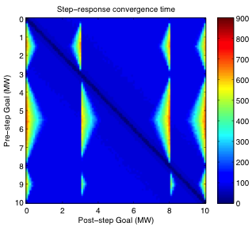
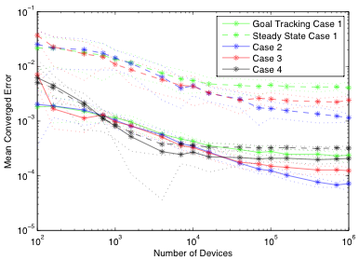
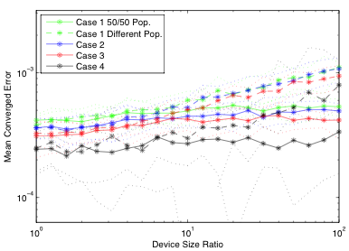
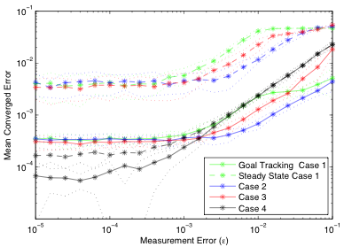
Simulation Studies
Scalable: More devices = better accuracy
Fast convergence matching predictions
Good tolerance of heterogeny and error

Slide 24

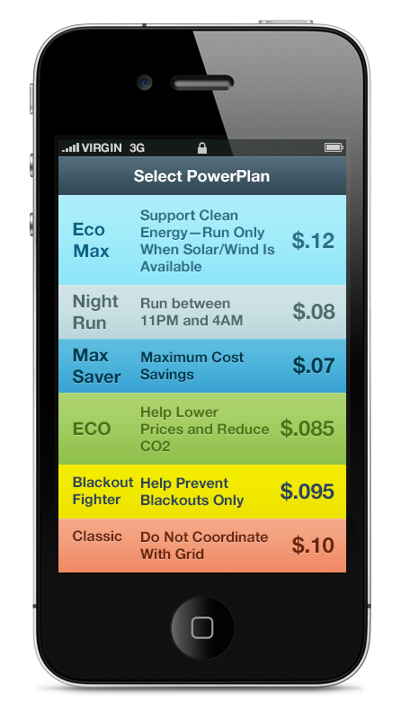
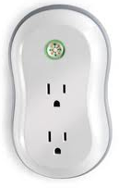
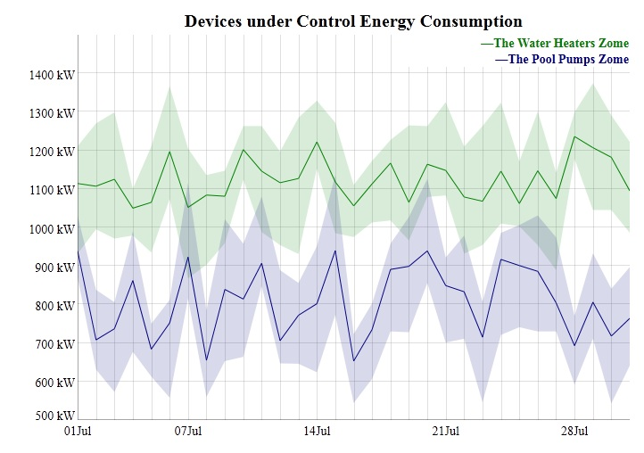
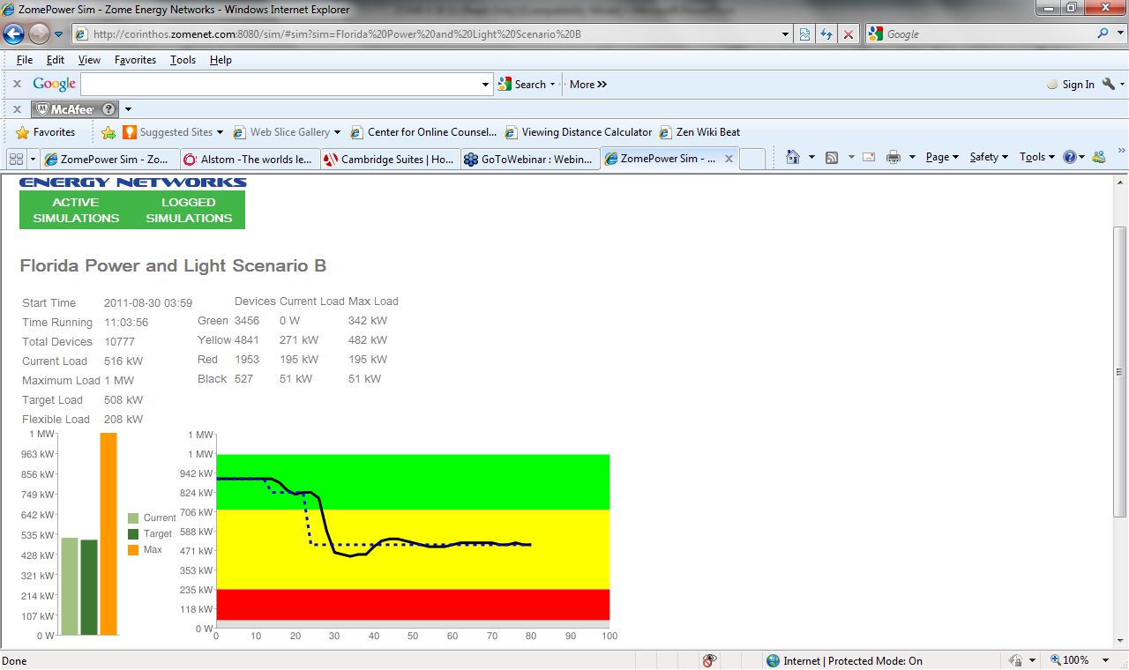
Current State: Transition to Pilots…
Partnership with energy industry startup
Integration and product development
Market integration
Consumer HCI & incentives
Operations interface
PDD, reference designs
Service models
…

Slide 25
Outline
Engineered Self-Organization
Three techniques:
Networks as manifolds
Stochastic coordination
Functional blueprints
Summary & Future outlook

Slide 26

MADV: Morphogenesis for Redesign
Operation experts are not engineering experts…
... but have good ideas for new uses and upgrades

Slide 27


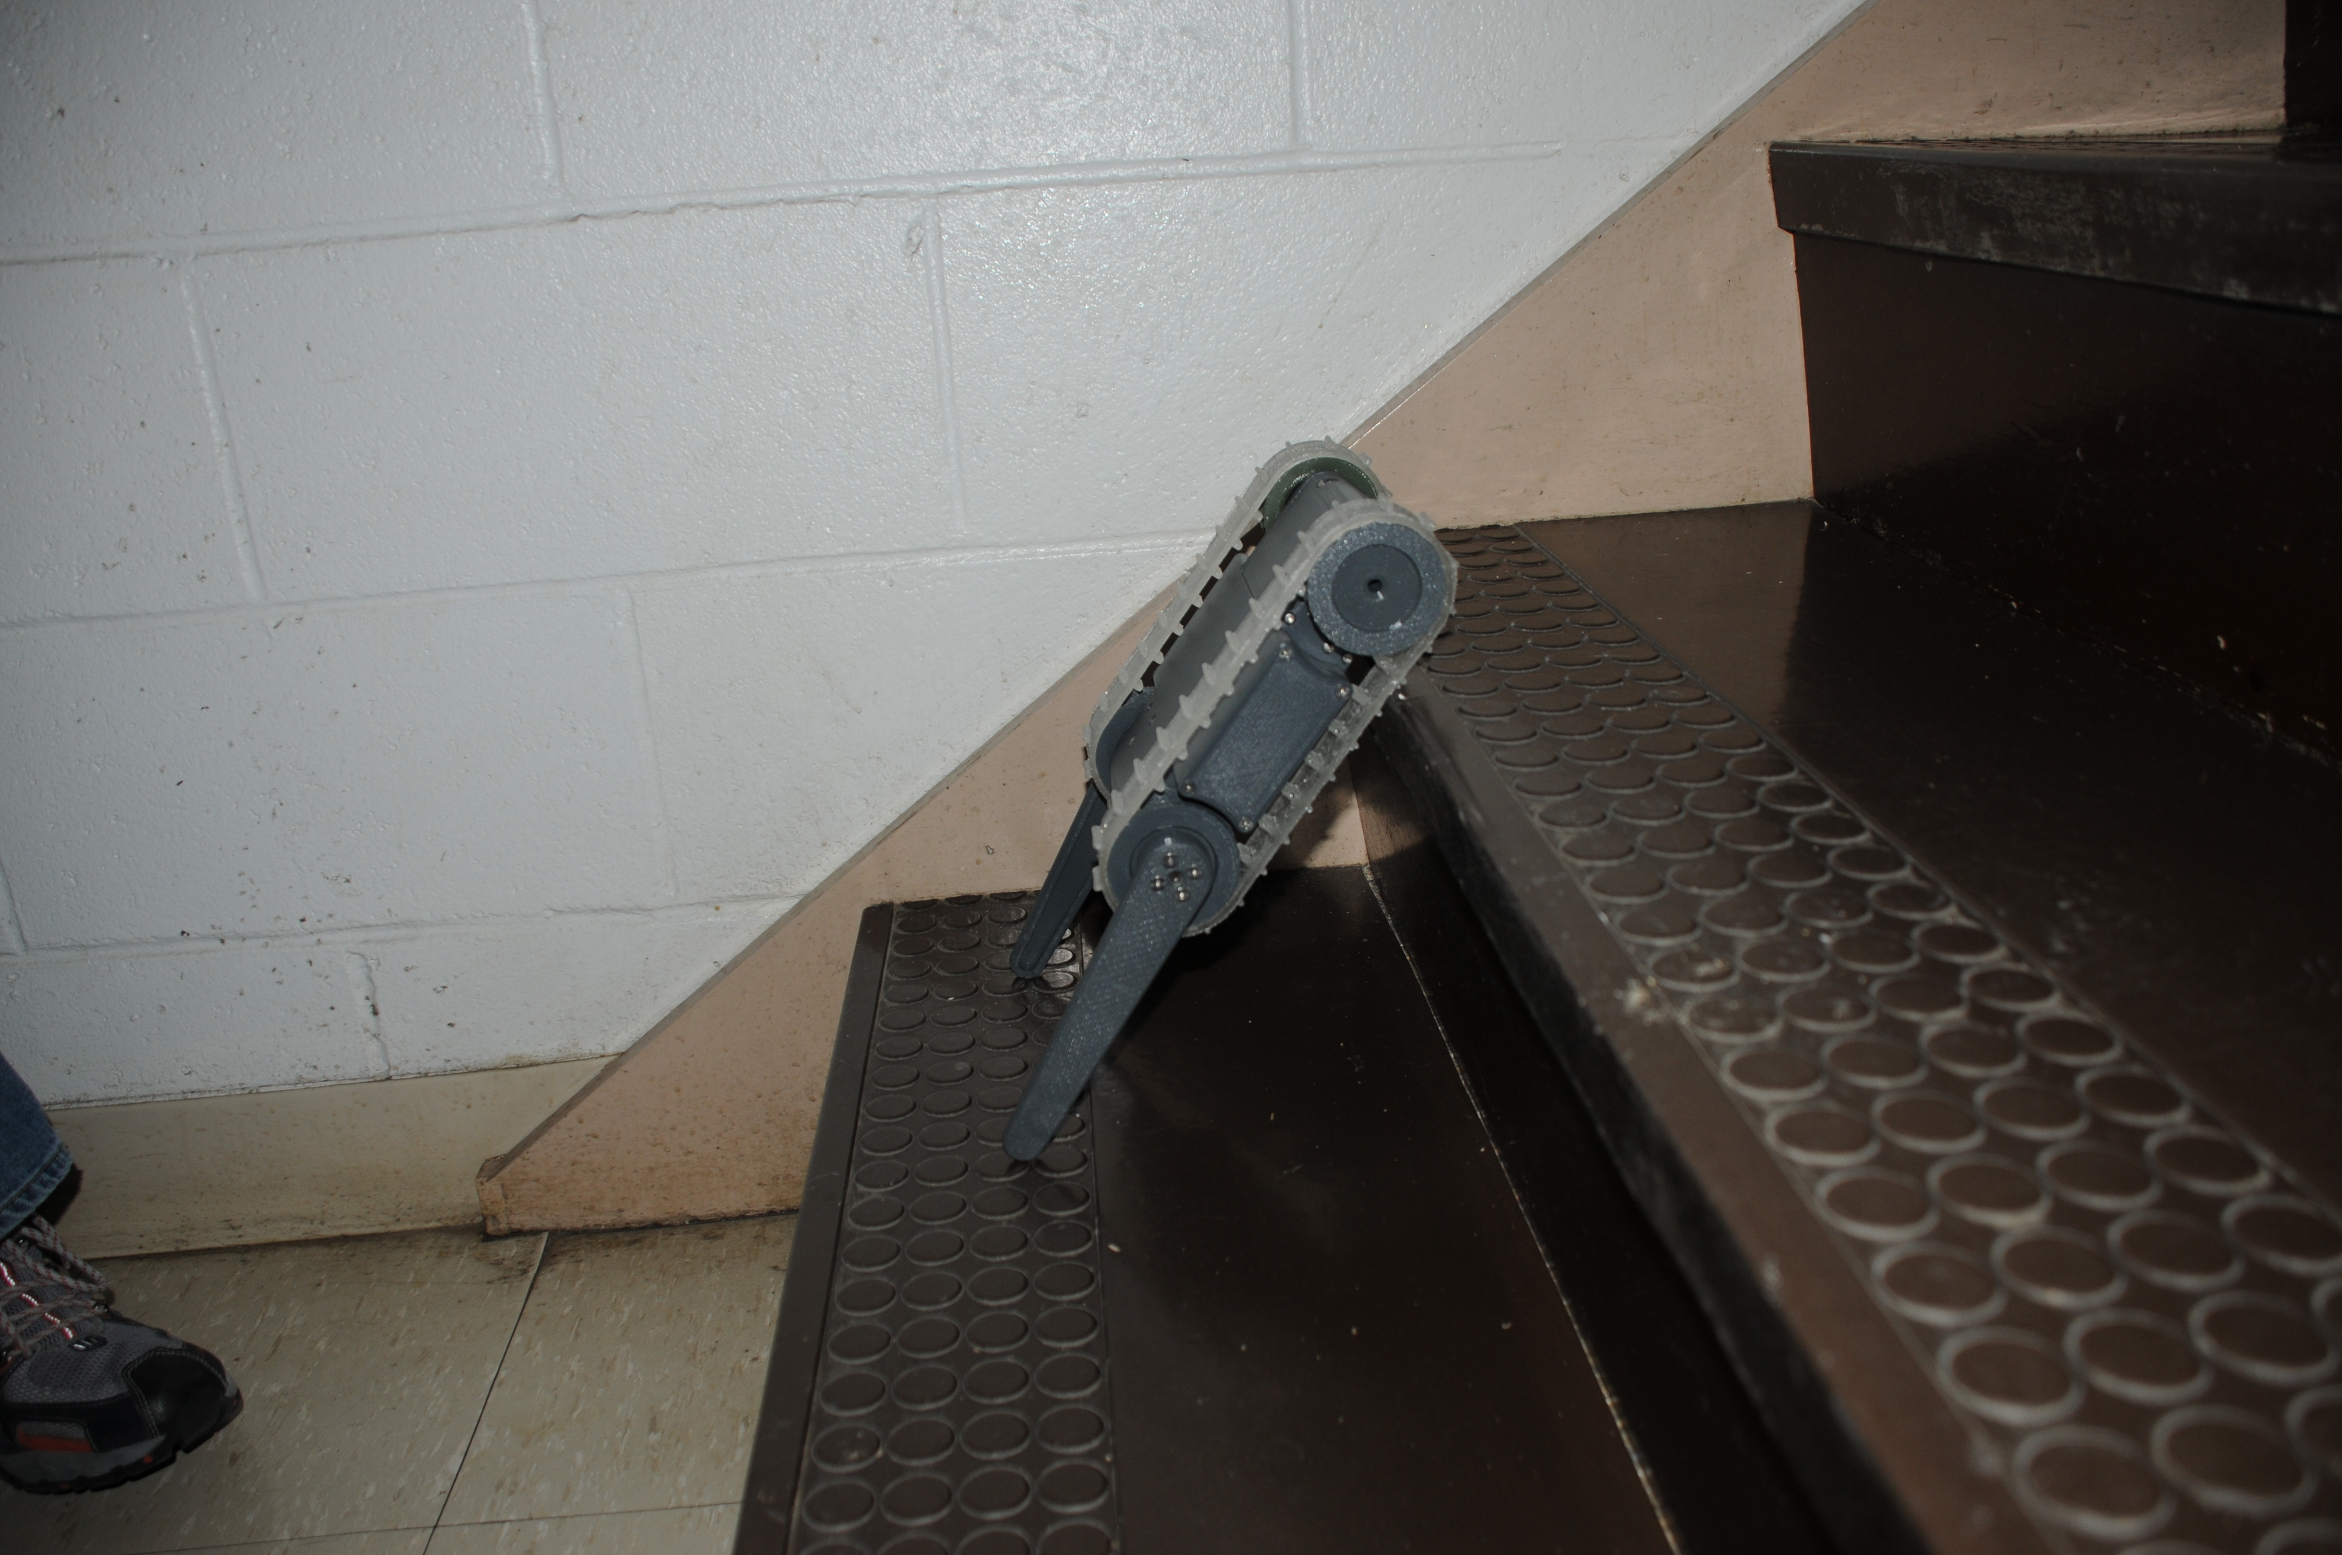

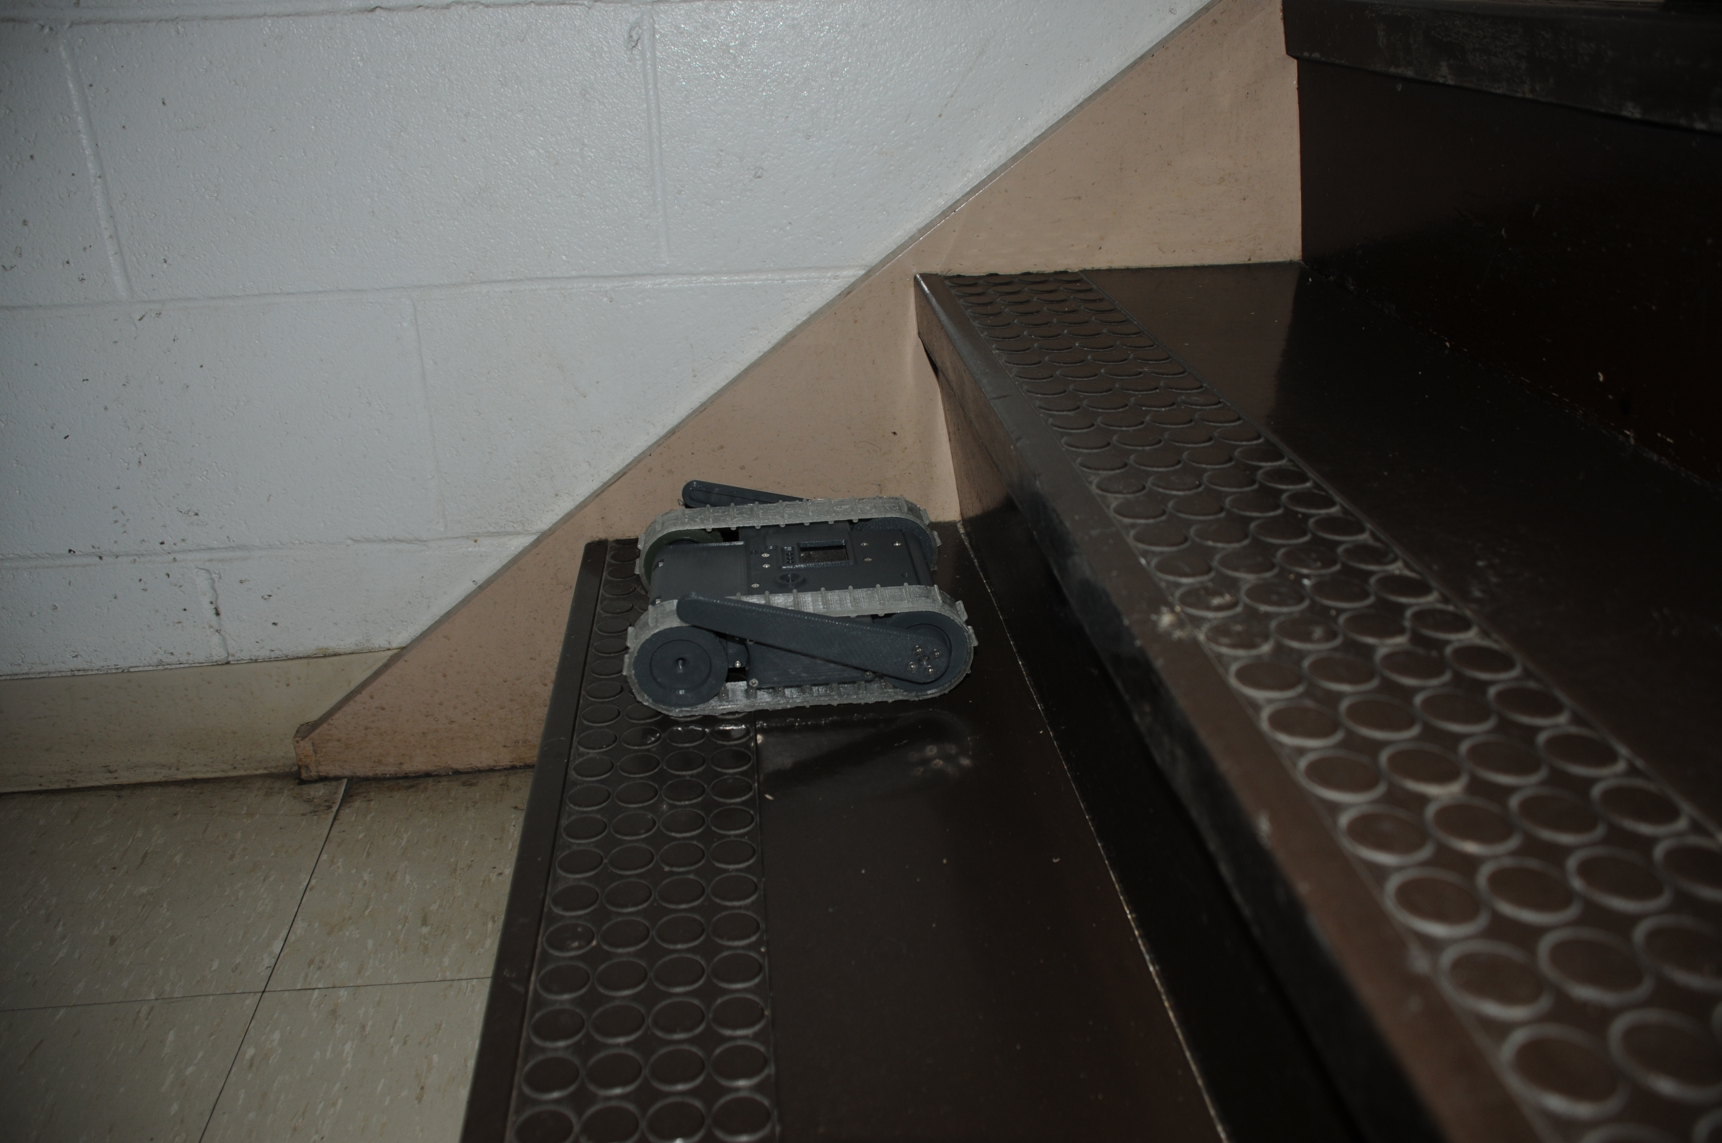
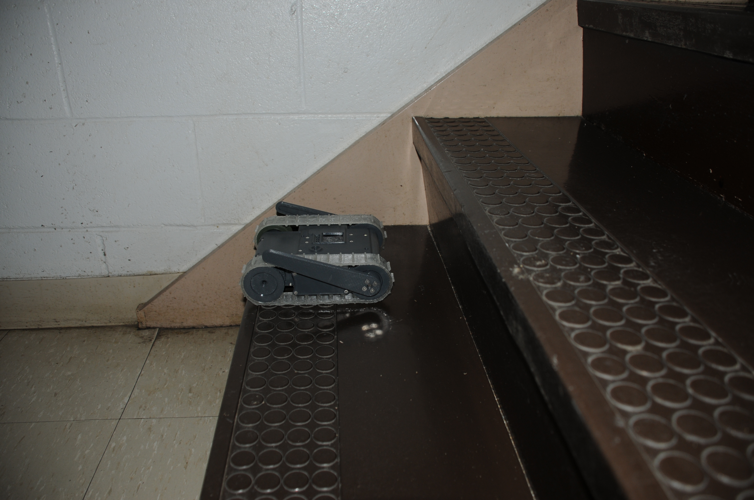
What if your robot can climb stairs…

Slide 28
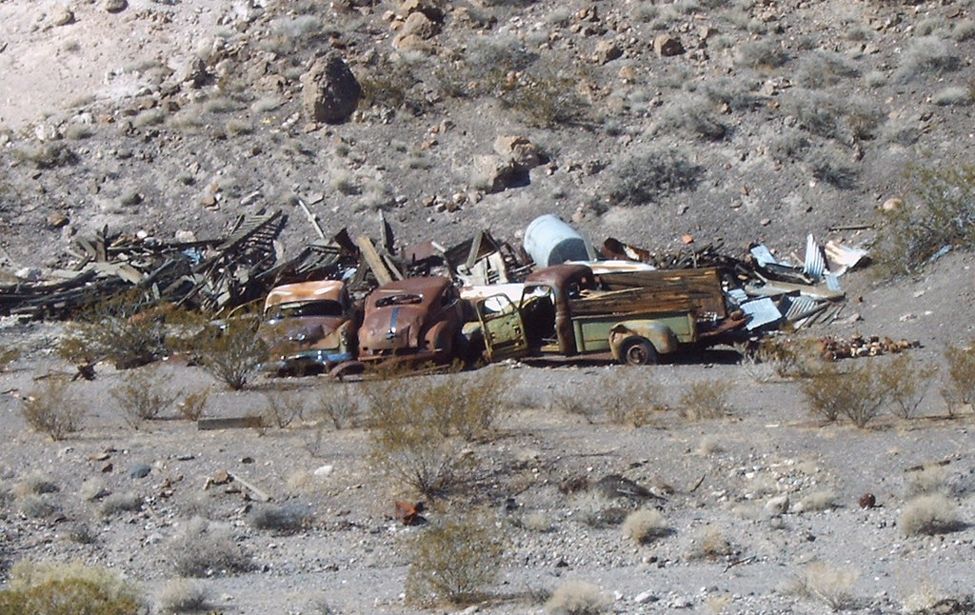
… but you want to check cars for IEDs?

Slide 29
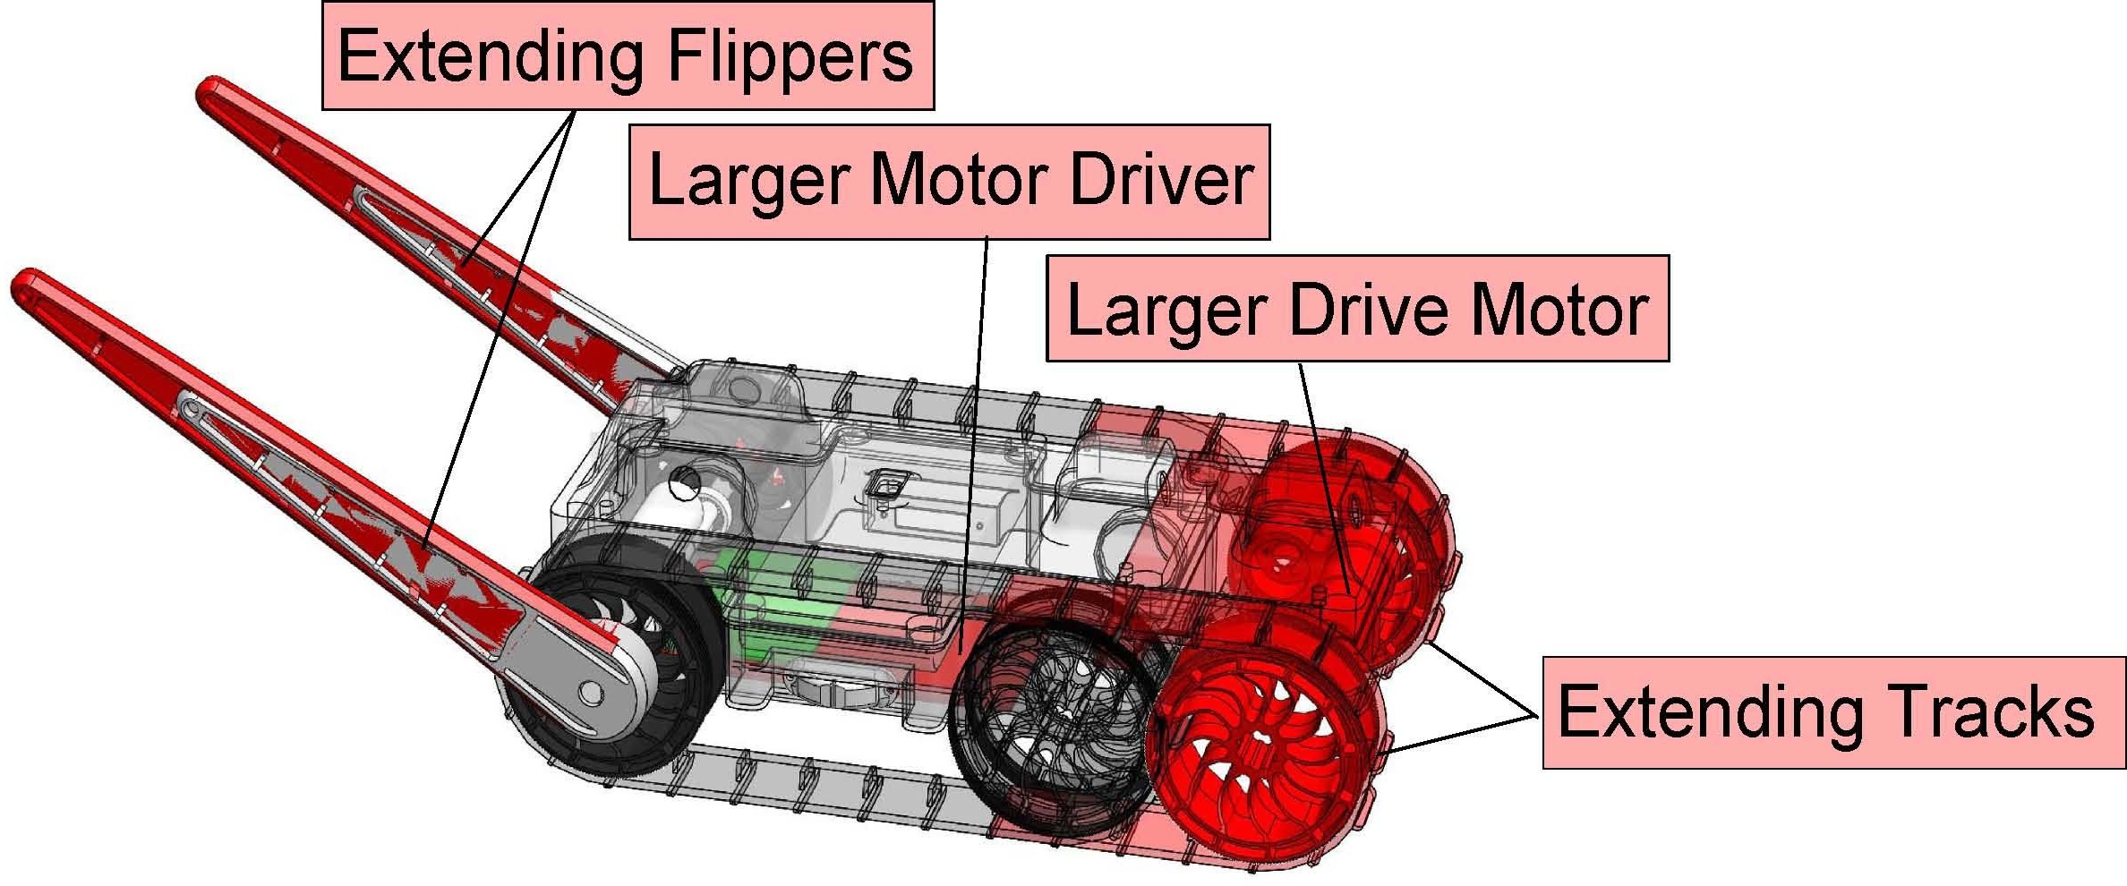
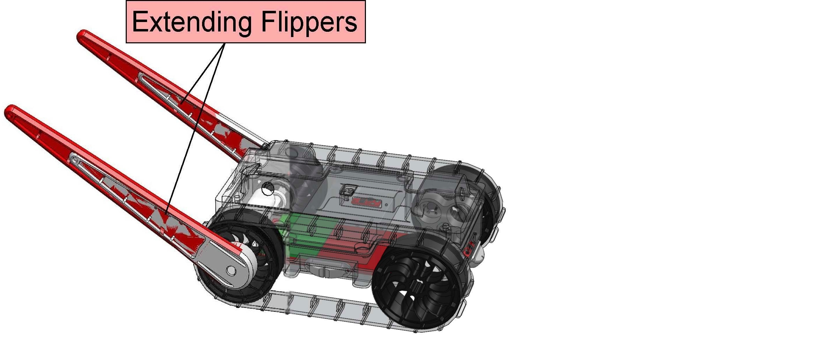
Problem: Robot Redesign Complexity
Even “simple” robots require careful design of many interacting components…
… and small changes have large consequences.

Slide 30
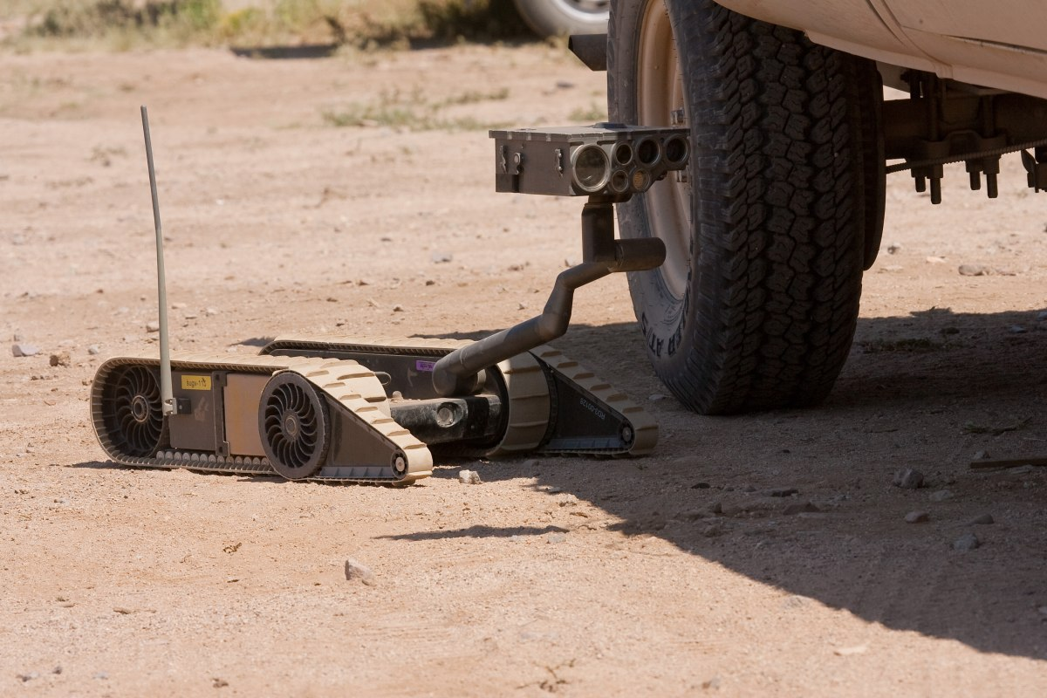
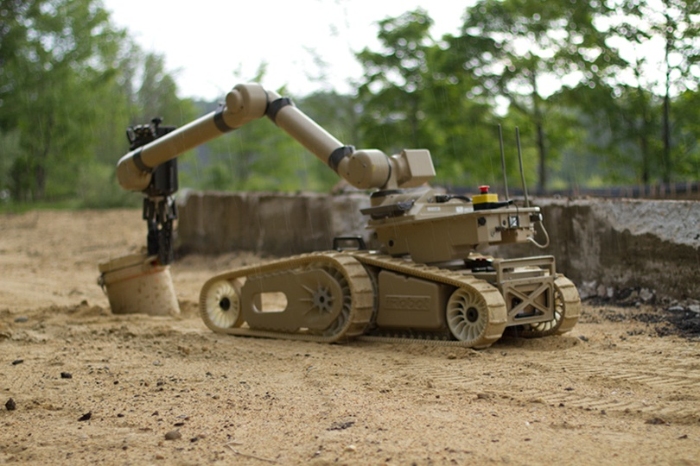
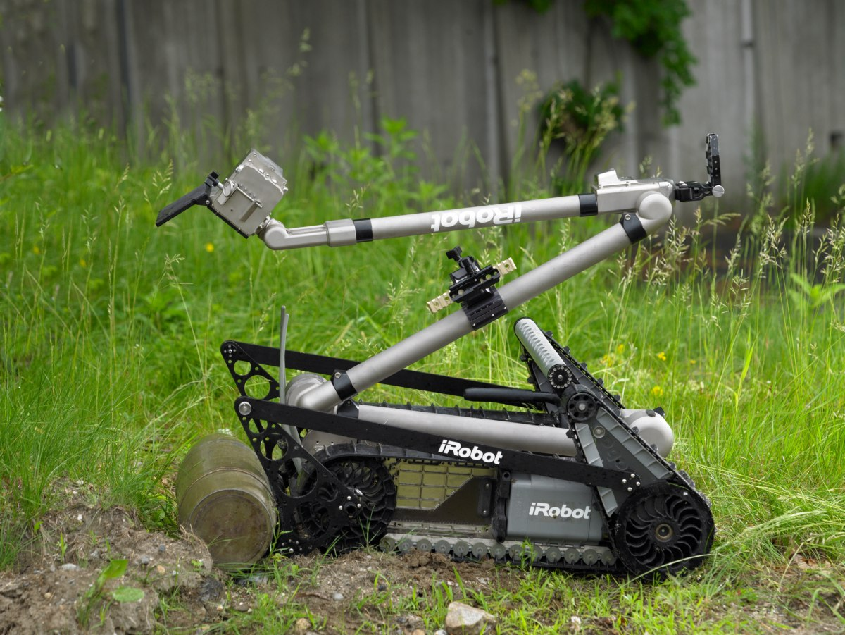
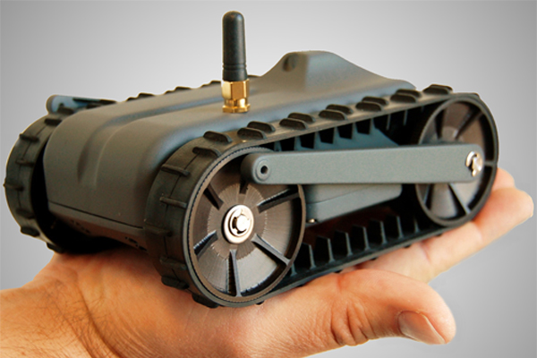
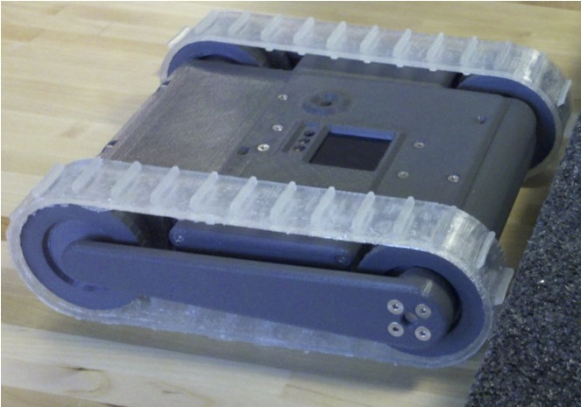
A phylogeny of engineered systems?
SUGV
Warrior
PackBot
LANdroid
miniDroid

Slide 31
Functional Blueprints
Functional blueprints requirements:
Behavior that degrades gracefully
Metric for stress degree & direction
Stress must be between 0 and 1
Incremental adjustment program
Initial viable design
Global: design specification
Local: parameter values
Link: functional blueprint
Examples:
Step Climbing
(via ascent angle)
Flipper/Body Ratio
Self-Righting
(via torque/mass)

Slide 32
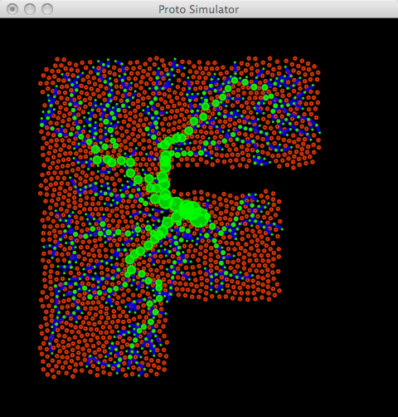





Preliminary Test: Cartoon Vascularization
Functional blueprint model of vascularization
Stress: oxygen, elastic stress
Adjustment: leaking, vessel grow/shrink
Red cells are healthy, blue cells are oxygen-deficient
Can model vascularization and density co-regulation
[Beal, Swarm Intel. 2010]

Slide 33



MADV Architecture
Models
Updated Design
Current Design
Morphogenetic Simulator
Evaluators
Functional Blueprints (FB)
Blend Updates
Robot Model Evaluator
Cost Evaluator
FB Executor
Environmental Evaluator (obstacle courses)
Blend Stresses
Stress Converter
Evaluation Metrics

Slide 34
Incremental Changes Ensure Progress
Incremental, not evolutionary!
Always keep design viable
Stress-modulated incremental changes
Stress disperses quickly through the network of functional blueprints
Blending function
0.0020
0.0015
0.0010
0.0005
No need for best design, just some working design
[Adler et al., ICMC 2011]

Slide 35









Morphogenesis resolves design constraints
Manifold evolution based on biological development
Implicit parameters specified through geometric relationships developed between components
Abstraction of components
Reduced dimensionality
Greater design flexibility
Flipper Length = Axle + Extension
[Beal et al., GECCO 2012]

Slide 36

Example: Climbing a larger step
7 interacting functional blueprints

Slide 37

And on toward complete blueprints…

Slide 38
Outline
Engineered Self-Organization
Three techniques:
Networks as manifolds
Stochastic coordination
Functional blueprints
Summary & Future outlook

Slide 39
Summary
Engineered self-organization helps with hard problems of design, scalability, and maintenance
No silver bullet --- but many useful techniques
Global: | Communication Network | Aggregate Demand | Design specifications
Local: | Message passing | Appliance power consumption | Individual design parameters
Model Enabling Composition: | Amorphous medium | Law of Large Numbers | Functional blueprints

Slide 40
Three Strands of Development
Discovery / adaptation of new self-organization phenomena to provide global behaviors
Refinement of self-organization phenomena into engineering techniques suitable for routine use
Application to real-world problems of systems design and maintenance
Example: functional blueprints
Example: spatial computing with Proto
Example: ColorPower stochastic control

Slide 41


Acknowledgements
Aaron Adler
Brett Benyo
Jeff Berliner
Jeff Cleveland
Ryan Irwin
Susan Katz
Brian Krisler
Jessica Lowell
Gretchen Markiewicz
Hala Mostafa
Kyle Usbeck
Fusun Yaman
Interns: Katie McGuire, Taylor Campbell
Annan Mozeika
Benjamin Axelrod
Vinayak Ranade
Kevin Hunter

